Slide 1
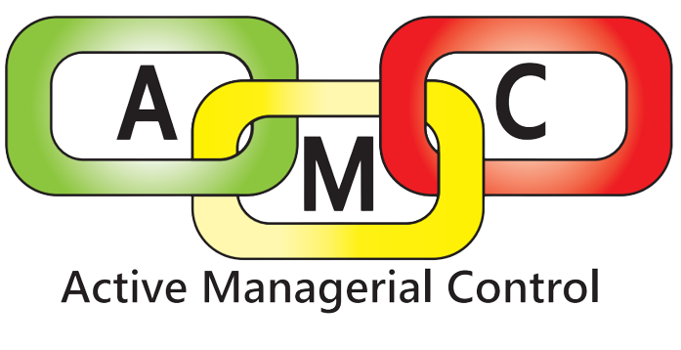
Northern Nevada Public Health
Environmental Health Services
Consumer & Food Protection Program
Notes:
Mention the newsletter, mention placarding, have everyone introduce themselves with their establishment names.

Slide 2
What We Do
Environmental Health Services
Training & Special Projects
Consumer & Food Safety Program
Waste Management/ UST/ Land Development/ Water Program
Permitted Facilities & Vector Program
“Ensures compliance with local, state, and federal laws regulating food, waste, water, vector and other areas of public health in Washoe County.”
Enforcement of regulations as well as education
“Collaborative approach with industry to meet established public health goals”
Source: Environmental Health (EHS) (nnph.org)
Notes:
In Environmental Health Services, we permit for a wide range of activities to ensure that our community stays healthy. If you look at the graphic on the screen you can see that our division is made up of four sections. Everyone here today is permitted with the consumer and food safety program.

Slide 3
Consumer & Food Protection Program
Consumer & Food Protection Program
Food Safety Outreach & HACCP Plan Review
Review submitted HACCP and Operational Plans for approval
Active Managerial Control Program and Community Outreach
Special Events & Foodborne Disease
Reviews and Approves Construction Plans for Food Facilities
Plans
Conducts Temporary Food Inspections
Responds to Foodborne Illness Outbreaks
Follow up with Food Facilities to Ensure Compliance over time
Training, Enforcement, & Special Projects
New employee training programs
Communication & coordination of elevated enforcement actions
Ad hoc projects valuable to consumer protection
“Strives to maintain the highest level of food safety in Washoe County”
Conducts annual and biannual inspections of food facilities to ensure compliance with current food safety regulations.
Community outreach and education regarding food safety principles and practices.
Source: Food Safety Services (nnph.org)
Notes:
In the consumer and food safety program, we have four subprograms that each work on a specific section of food safety to ensure that we are providing as must help and information as we can. Today’s Active Managerial Control Course is part of our community outreach and education component. We want to make sure that we are giving you all the information that we possibly can to help you stay in compliance with the food establishment regulations. Our goal is to work together to keep our community safe and healthy.

Slide 4
Objectives of this AMC Course
The What, Who, and Why
The How
What is Active Managerial Control?
Who should take this course?
Why is AMC important to you?
Why is AMC important to the public?
Components of an AMC Policy
How to write an AMC Policy
The Resource Library
Compliance and Enforcement
The End
Questions and Answers
Closing Remarks
Notes:
Review the objectives of the course –
Overall the course takes approximately 2 hours to complete depending on how many people are in the class.
We aren’t here to dispute regulations or discuss specific observations from your inspection, but if you do have questions, you are welcome to stay after the course to discuss.

Slide 5
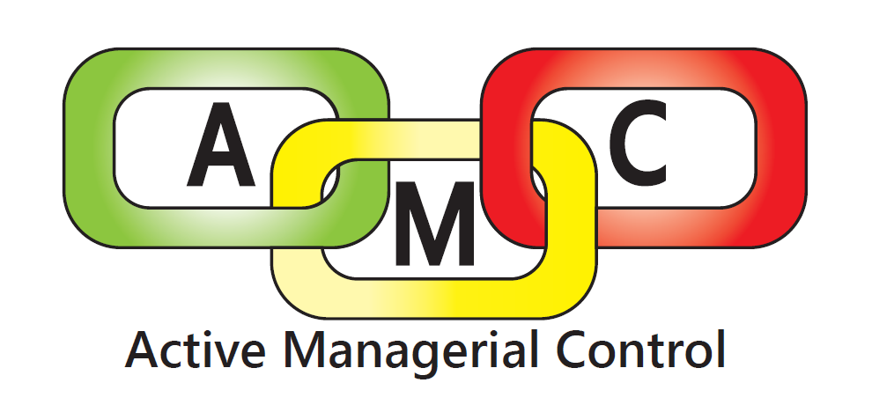
What is Active Managerial Control?
An investment in your business and the safety of your customers
5. A self-engineered plan for food safety, tailored to your business, that can evolve over time.
2. Creating and supporting a culture of food safety within your establishment
4. An informed sense of confidence for you AND your staff
3. A toolbox for information and resources about food safety practices
Notes:
What is Active Managerial Control?
“The purposeful incorporation of specific actions or procedures by industry management to attain control over foodborne illness risk factors” (FDA, 2022).
What is Active Managerial Control actually?
An investment in your business and the safety of your customers
Harnessing Active managerial control over food safety in your establishment is an investment of time, but it comes with a large return on investment. Habitual food safety practices means you can focus running your business and your customers can focus on how delicious your food is.
Creating and supporting a culture of food safety within your establishment
Creating a culture of food safety means that food safety practices are habitual for your staff, that every staff member genuinely cares about food safety, and that every staff member feels supported in their role to protect food safety.
A toolbox for information and resources about food safety practices
The toolbox is an online library of food safety resources that is available 24/7 for you to reference and use for staff training.
An informed sense of confidence for you AND your staff
Harnessing AMC means you can take micromanaging and worry out of maintaining food safety.
A self-engineered plan for food safety, tailored to your business, that can evolve over time.
You develop amc in your establishment by developing policies that protect food safety while being practical for you and your business.

Slide 6
What is Active Managerial Control?
Food From Unsafe Sources
Reheating Foods
Sanitizing Food Contact Surfaces
Cooling Foods
Proper
Datemarking
A proactive plan to help you mitigate the greatest risks to food safety in your establishment.
The development of:
Policies that are unique to the practices occurring at your establishment
Training that is relevant, impactful, and inspiring and consistent
Verification routines that provide a clear path to ensure food safety practices are being followed
Dirty/ Contaminated Equipment
Improper Holding Times and Temperatures
Hot-Holding Foods
Common Critical Violations
Cold-Holding Foods
Employee Health
Improper Cooking
Poor Personal Hygiene
Contamination
Chemical Storage
Improper
Handwashing
Bare Hand Contact with Ready-to-Eat Foods
Refrigerated Storage
Notes:
In the AMC program, we provide you with the tools to be proactive about food safety in your establishment.
Take a minute to look at the graphic displaying some of the most commonly-observed critical violations. Do any of these look familiar? Most likely each of you are here today because one of these violations is routinely observed in your establishment. Active Managerial Control helps you continuously track and stay on top of these issues, so they don’t become a problem for your staff, your customers, or your health permit.
Part of being proactive with food safety is the development of functional policies, training programs, and verification routines for the greatest risk factors in your establishment. While this course facilitates plan development through focused time and information, the most important characteristic of your AMC plan is that it is created by you and is unique to your establishment – because no one knows your practices and facility better than you do.

Slide 7
Who should take the AMC course?
Who develops AMC documents and resources?
Managers and persons in charge
must have the ability to cultivate change
The establishment’s Certified Food Protection Managers
Key players throughout all levels of establishment staff
Who is affected by AMC?
Restaurant owners and managers
FOH and BOH restaurant staff
Consumers and patrons of local food establishments
Notes:
Active Managerial Control should start at the managerial level and work its way through all levels of staff because functional and sustainable active managerial control is maintained at all levels of staff.
Managers and persons in charge should lead by example and include key players in the development of food safety plans and procedures. Get to know what works for your staff: how can food safety be both practical and likely.
Active Managerial Control increases food safety in food establishments and sets a clear, designated set of practices and goals. This results in improved confidence for your staff at work, for the security of your business, and for the safety of your customers.

Slide 8
Why is Active Managerial Control Important?
What challenges do you face as a manager or owner of a restaurant?
What Active Managerial Control can do for YOU:
Reduce stress
Increase staff confidence in their tasks and employee buy-in
Reduce Food Waste
Happy customers!
Notes:
Earlier we looked at the infographic of common critical violations that are observed in food establishments. I want each person to take this opportunity to share what you’ve been challenged by in this business that doesn’t have to do with food safety. Imagine your friend comes to you and says “I want to open a restaurant; it will be the easiest job in the world once I have it opened. I have nothing to worry about.” What would you tell your friend?
Each person should share what challenges they face as a manager or owner of a food establishment. Everyone should share so that the people in the class realize that they are not alone in feeling challenged.
I think we can all agree that you face a lot of challenges by owning or managing a restaurant. Challenges like staff shortages, inflation prices on food items, staff turnover – I once inspected a restaurant where they had 40 reservations and two people didn’t show up for their shift. Many of the challenges that you face are out of your control – what is in your control are the practices that support food safety. I know that AMC can seem like one more thing to do. But here is what AMC can do for you:
Raise your hand if you’ve ever felt nervous about a health inspection. With functional and practical food safety policies, you don’t have to worry about an unexpected inspection. Active Managerial Control can take worrying about food safety off your plate.
Active Managerial Control requires that all food handlers are consulted when developing food safety procedures as they are stakeholders for the policy being practical and complete. With AMC, the training for new hires will be thorough and consistent. This improves employee’s buy-in to the practices being instituted, while increasing their confidence in their job duties. AMC procedures are also iterative, meaning that they can change over time. This means that employees can feel comfortable speaking up when a procedure is no longer practical, and they know that they will be answered with meaningful change – creating a more positive and inclusive workplace.
When food spoils, is handled improperly, or is found to be unsafe, then it must be discarded. With how expensive food is, and with what we know about the ecological consequences of food waste, I know that no one in here wants to discard food because it was handled or stored improperly. With Active Managerial Control established in your facility, the likelihood of needing to discard food due to improper handling decreases significantly.
Finally, I think it’s obvious that AMC protects food safety, which in-turn protects your customers and makes sure they come back again. Serving safe food makes the consumer, the health district, and all you folks, happy.

Slide 9
Why is AMC important to the public?
AMC supports food safety in your establishment and food safety keeps your patrons healthy!
Notes:
Why is food safety important to the public?
Foodborne Illness Video Testimonials -- Bernadette/Kate Jacobs – YouTube

Slide 10
Writing an AMC Policy
Verification
Able to evolve
over time!
Each policy should contain answers for the 5 Ws of any food safety practice:
What is the practice?
Why is it important?
Who does it apply to?
When will it be performed?
Where will it be performed?
How will it be performed?
Detailed training programs
Description of verification
Specific to your
establishment!
Training
Procedures
Notes:
Each AMC Policy contains three primary sections: Procedures, Training, and Verification. Each section should be developed with the others in mind. If you’re asking your staff to do something, you need to think about how will train them on that thing, and how will you verify success. In that sense each section works together so that your AMC policy answers detailed questions about the food safety practice for which it was written.
Specifically, [reference notes on slide].
AMC Policies are set up so that they are specific to your establishment – they are written by you and for you. And AMC Policies are able to change as your business evolves and as needed to ensure success.
We are going to do an exercise utilizing the AMC Policy Template, which outlines components of each section and is available on our Resource Library. Before we start the exercise, let’s discuss each section in greater detail.

Slide 11
Procedures
What is the practice?
Why is it important?
Who does it apply to?
When will it be performed?
Where will it be performed?
How will it be performed?
Corrective Actions
Monitoring
Notes:
Let’s first review the procedures section. This is the section where you answer the 5 W questions about your policy.
Technically, the “what” and the “why” are included in the heading. It’s not only the most logical location for this information, but it also underscores the remainder of the policy by establishing purpose for the policy from the start.
What: This is where you put the policy title, such as “Cold Holding TCS Foods” or “No Bare Hand Contact with Ready-to-Eat Foods”. It should be clear and concise for anyone trying to use the policy.
Why: In this section, you want to include a description of the food safety hazard and the expectation. Be sure to include any metrics that clarify the hazard and expectation. For Cold-Holding TCS Foods you might say: “Illness-causing bacteria multiply rapidly in the temperature danger zone (between 41°F and 135°F). To prevent rapid bacterial growth, all cold, time/temperature control for safety (TCS) food(s) must be maintained at or below 41°F.”
“Who does this apply to?” Describe who this policy applies to. Ask yourself “who would I expect to be responsible for this process?” Try to be specific and detailed, without limiting your freedom for revisions. Once you have identified who is responsible, it is critical to include these people in the development of the remainder of the policy. Talk to the people who are going to be enacting the policy everyday to find out what methods are practical, efficient, and habitual. If the policy is clunky and burdensome, then your staff will not follow it and it will fail.
Bonus: Including staff in the development of the policy increases their buy-in, shows them how valuable they are to the business, and makes them feel more confident in their job responsibilities.
“When will this be performed?” For cold-holding, you might say “at all times” but for no bare-hand-contact you might say “when handling ready-to-eat foods.” Often the “when” is contingent upon what policy you are creating and what processes you conduct in your establishment. Remember: this policy is specific to your facility, so it should reflect the specific processes that you conduct and when you conduct them.

Slide 12
Procedures
What is the practice?
Why is it important?
Who does it apply to?
When will it be performed?
Where will it be performed?
How will it be performed?
Corrective Actions
Monitoring
Notes:
“Where does this take place?” Should describe where the process will take place. Do you have specific refrigerators that exclusively store raw animal products? This should be clarified when developing a Refrigerated Storage policy. Maybe you have a several refrigerated shelves that you specifically use for cooling foods; include these specifics in your Cooling Foods Policy. There might be several different areas and that’s okay too. Your No BHC with RTE foods plan might state “The prep counter when cutting vegetables and the make-up unit when assembling salads.”
“How is this this completed?” This section is where you write the critical limits for the policy you are writing. This can be as simple as “All cold-holding time/temperature control for safety food items must be held at or below 41F” or “Employees must wash hands when changing tasks, when returning to work from the restroom or from a break, and after handling areas of high contamination.” You should also include details about special utensils or methods that you can employ to keep food safe. For No BHC with RTE Foods, you might state “Food handlers must wear single-use gloves when handling ready-to-eat foods” and for cooling you might say “Soups and stews must be placed in an ice bath and stirred with an ice paddle once every 10 minutes.”
In the Corrective Action section, you must list the steps that will taken to ensure food safety if someone makes a mistake. If you open the fridge and see that the all the food is above 41F, then the corrective action would be to discard out of temperature TCS foods. Maybe you’re cooling shredded chicken and you see that an hour has passed and it’s only cooled from 135F to 130F; you can reheat the chicken one time to 165F and start the cooling process again while being extra attentive to the food that is cooling.
Finally, the monitoring step. This section answers the question: How are you going to keep track of the critical limits that are being observed in your policy? A common and easy way to monitor critical limits is to maintain logs on-site. When the shift lead measures the temperature of refrigerator, they record the temperature, and any corrective actions taken (if necessary) on the log. Logs also enable easy verification of policy success. However, for many facilities, asking staff to maintain a log is not practical. Monitoring can be that managers will check in with employees, make sure they have what they need to succeed, and observe for proper processes.
Once again, AMC policies are are specific to your facility and able to be revised. Think about what works well for you and your staff. Don’t feel discouraged if your policy doesn’t succeed the first time. Identify and learn from what didn’t work and then revise your policy as necessary.

Slide 13
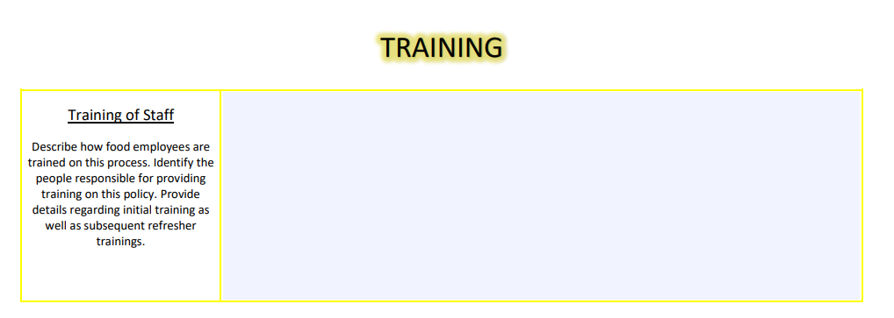
Training
Who is responsible for training staff on this policy?
How will staff be trained?
New employees
Refresher training
TEACH
DEMONSTRATE
PRACTICE
Notes:
Now that you have created detailed and practical procedures, it’s time to train your staff. Training is the opportunity to convey knowledge of food safety procedures to your staff.
The training section should identify who is responsible for training employees on the policy. Identifying this person provides a clear expectation for the trainer. It also identifies who staff can go to if they questions or need more help.
How will your staff be trained? There could be a computer component or employees are expected to shadow the trainer for a shift or maybe they complete a worksheet. Whatever your training process, you should identify training for new employees and refresher trainings. Refresher training is your opportunity to periodically and regularly revisit procedural food safety knowledge and ensure consistency throughout your facility. You can make sure that all of staff are on the same page.
But most importantly remember that training occurs from the top down. So, it starts with you.
- Teach your staff the procedure. Let them know what their role is and why it’s important.
- Demonstrate the proper procedures. By showing your staff how to do it, you reinforce their knowledge and cater to different learning styles. Either way, you’re putting words into practice.
- Practice the proper procedures. This means leading by example. If you’re disregarding food safety, then your staff will disregard it as well. And through practicing the procedures, you may find that the procedures are burdensome, and some changed to your policy need to be made.

Slide 14
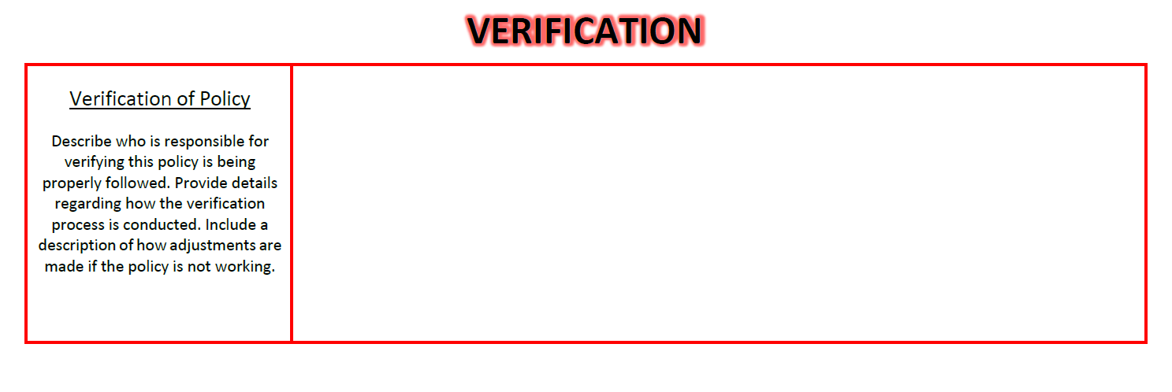
Verification
Are procedures being followed?
Was your training program successful?
COMMUNICATE
Notes:
And just like that we are at the verification step. Verification is the most important part of an AMC policy.
Verification is how you determine if your procedures are being followed and if your training program is successful.
In this section you should identify who will be responsible for verifying that the policy is being followed. Detail how the verification process is conducted. For example, the identified person might review logs for accuracy and consistency each day. Or maybe once per week, you walk through the facility as though you’re a health inspector – you can even use our self-inspection checklist which is available in the Resource Library. Whether you have physical documentation or not, verification should always include checking in with staff and communicating about what is working and what is not working with the policy.
Finally, describe your process for adjusting the policy if something isn’t working. This is kind of like the Corrective Action step for verification.

Slide 15
We’ll meet back in 10 minutes!!

Slide 16
Exercise: Writing AMC Policy Procedures
Everyone has been given a critical violation and a blank AMC Policy Template
Use the AMC Policy Template to briefly write food safety procedures related to the violation
Share with the group!
Notes:
You’ll have about 15 to 20 minutes to write the procedures, so it doesn’t need to be anything formal. In reality, you would have much more time to write procedures. Consider the details of each section and jot down what you think.
At the end of the time, everyone will share their assigned violation and procedures with the group.

Slide 17
COLD HOLDING
COOLING
COOKING
AMC Policy Exercise
1
2
3
Work with your group to create an AMC policy for your assigned violation
CROSS CONTAMINATION
EMPLOYEE HEALTH
4
5
6
7
8
FOOD CONTACT SURFACES
HOT HOLDING
HANDWASHING

Slide 18
The Food Safety Resource Library
Notes:
As you start to write your own AMC Policies for your establishments, one of the helpful resources available to you is our digital Food Safety Resource Library. A link to this page will be included in the follow-up email that I’ll send out, but I want to talk about it right now.
EHS Main Page
Access Info about all our programs
We are selecting Food Safety Services
Main Page include information about the Food Safety Program
You can access permitting guidance
You can access a link to the Washoe Eats App
At the bottom of the page is contact information for the program supervisors and EHS front desk
Blue ribbon on the left hand side has information specific to different subprograms – this is how you access information for special events permitting, foodborne illness reporting, and the inspection process. But today we checking out the Resource Library.
5. The Resource Library is split into multiple sections… etc.
Don’t forget that you can contact your routine inspectors with any questions or you can contact our front desk with general questions and they will connect you with someone in the food safety program who can help.

Slide 19
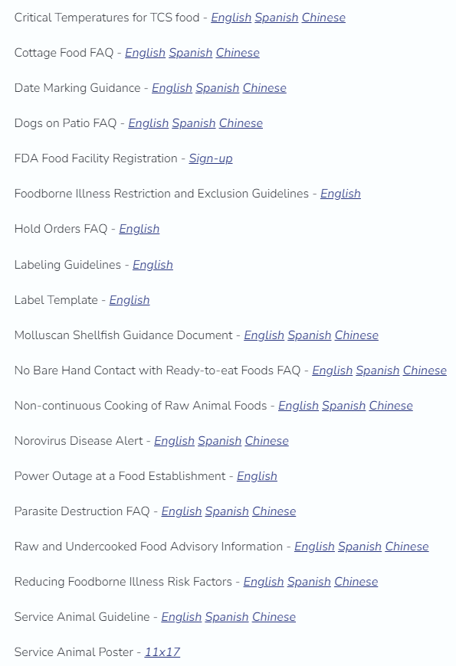
The Food Safety Resource Library
General Information and Frequently Asked Questions
Food Safety Handouts
Sample Standard Operating Procedures
Food Safety Logs and Record Keeping

Slide 20
AMC & The Enforcement Process
Office Hearing with Enforcement Supervisor & Elevated Enforcement Action
Reinspection & Fee
Within 72 Hours
AMC Class & 90-Day Reinspection
Pass – Proceed to next routine inspection
Routine Inspection
Pass – Proceed to next routine inspection
Pass – Proceed to next routine inspection
Thoughtful development of Active Managerial Control can break the cycle of repeat critical violations.
Notes:
To wrap up today, I want to go through our enforcement process to reiterate for those who are here as part of our enforcement program. But this is good information for all food establishment owners to keep in mind as they navigate this process.
Within the enforcement process the AMC Program functions as an extension on long-term correction of repeat critical violations. The AMC Program is specific to repeat critical violations observed in three consecutive inspections. Consecutive inspections means consecutive routine inspections or consecutive routine and reinspections.
Go through the chain of enforcement example

Slide 21
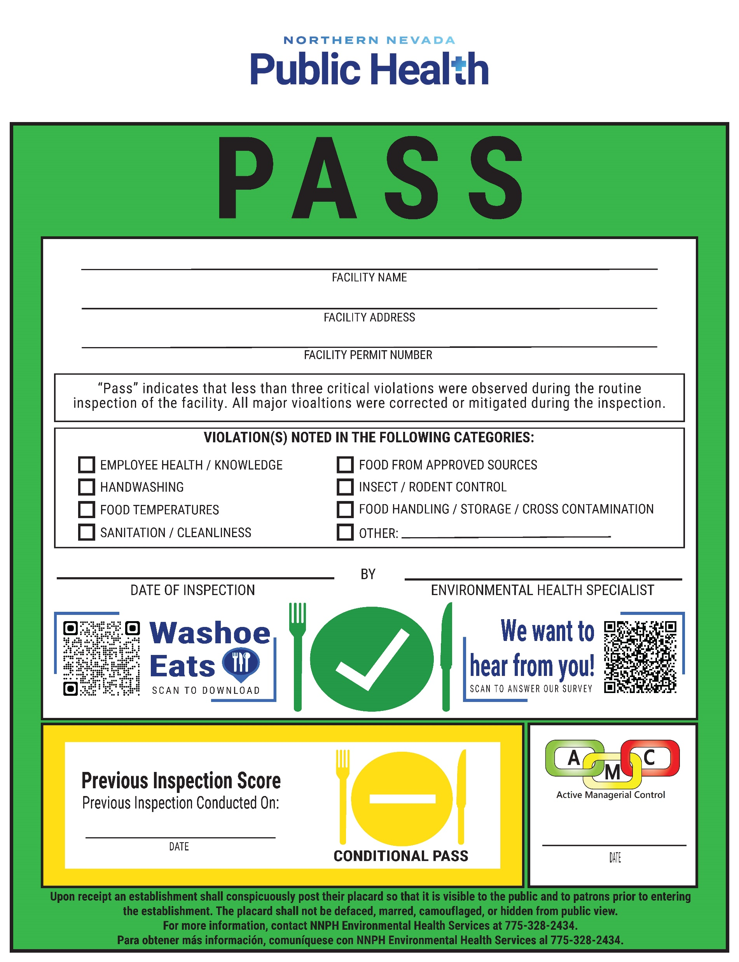
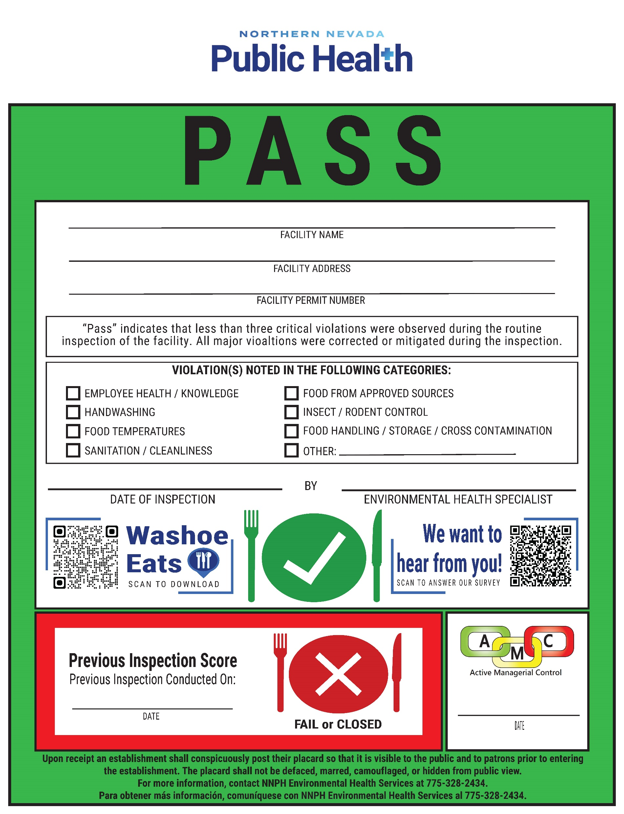
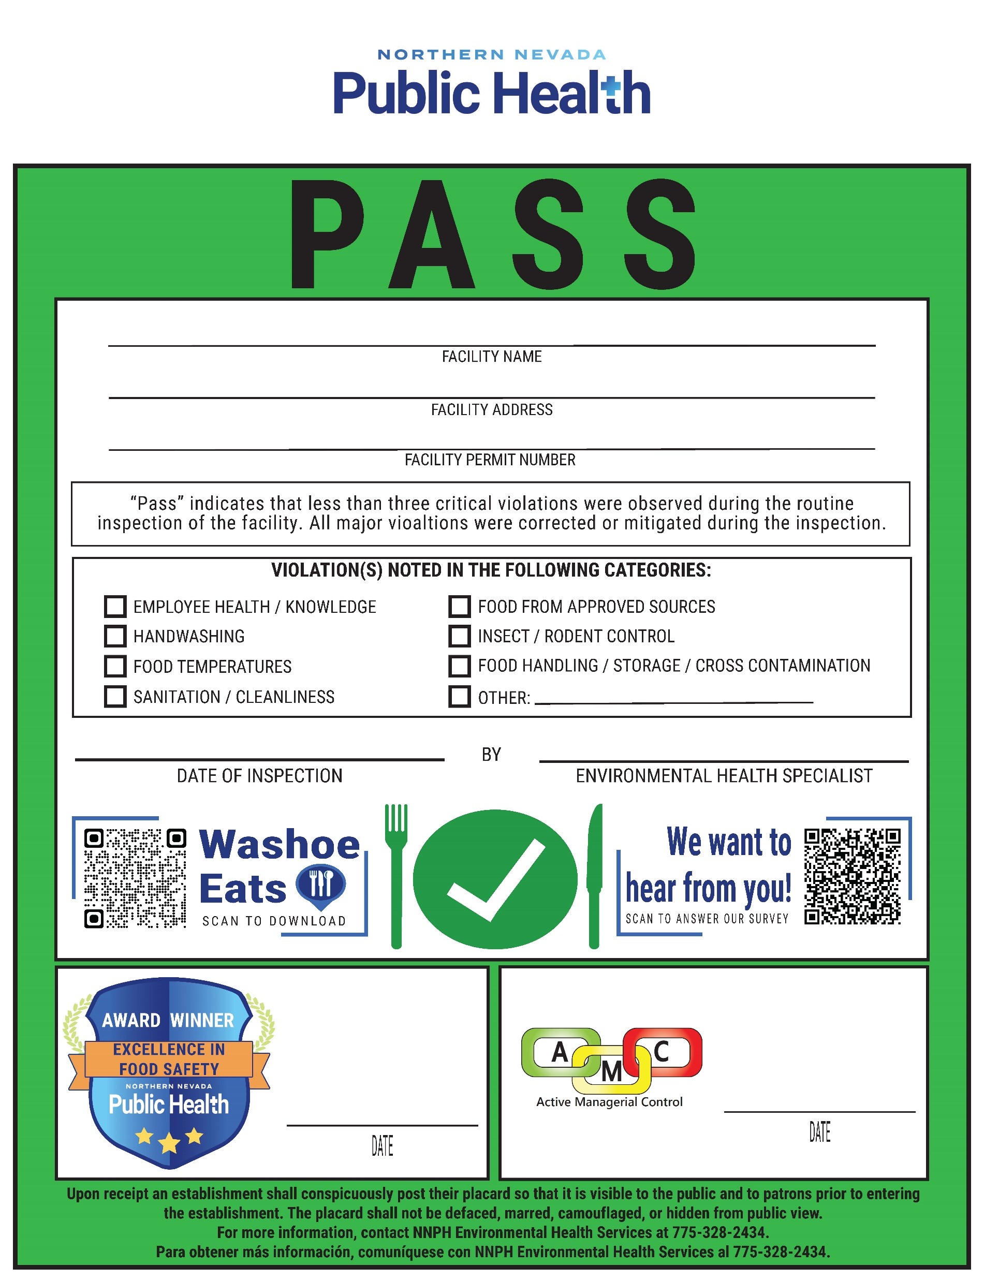
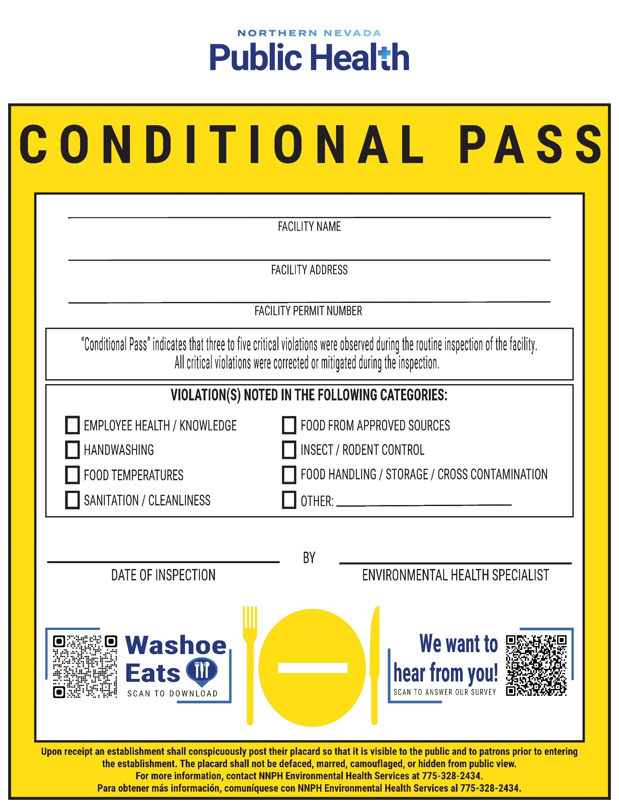
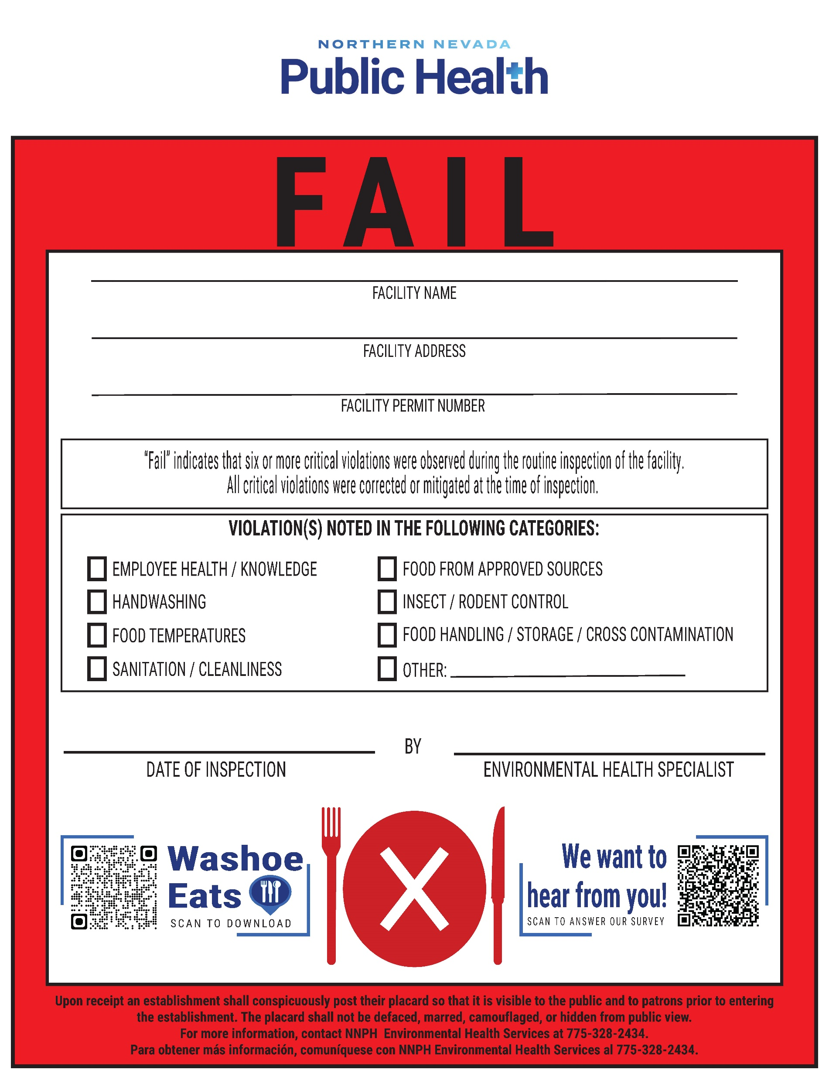
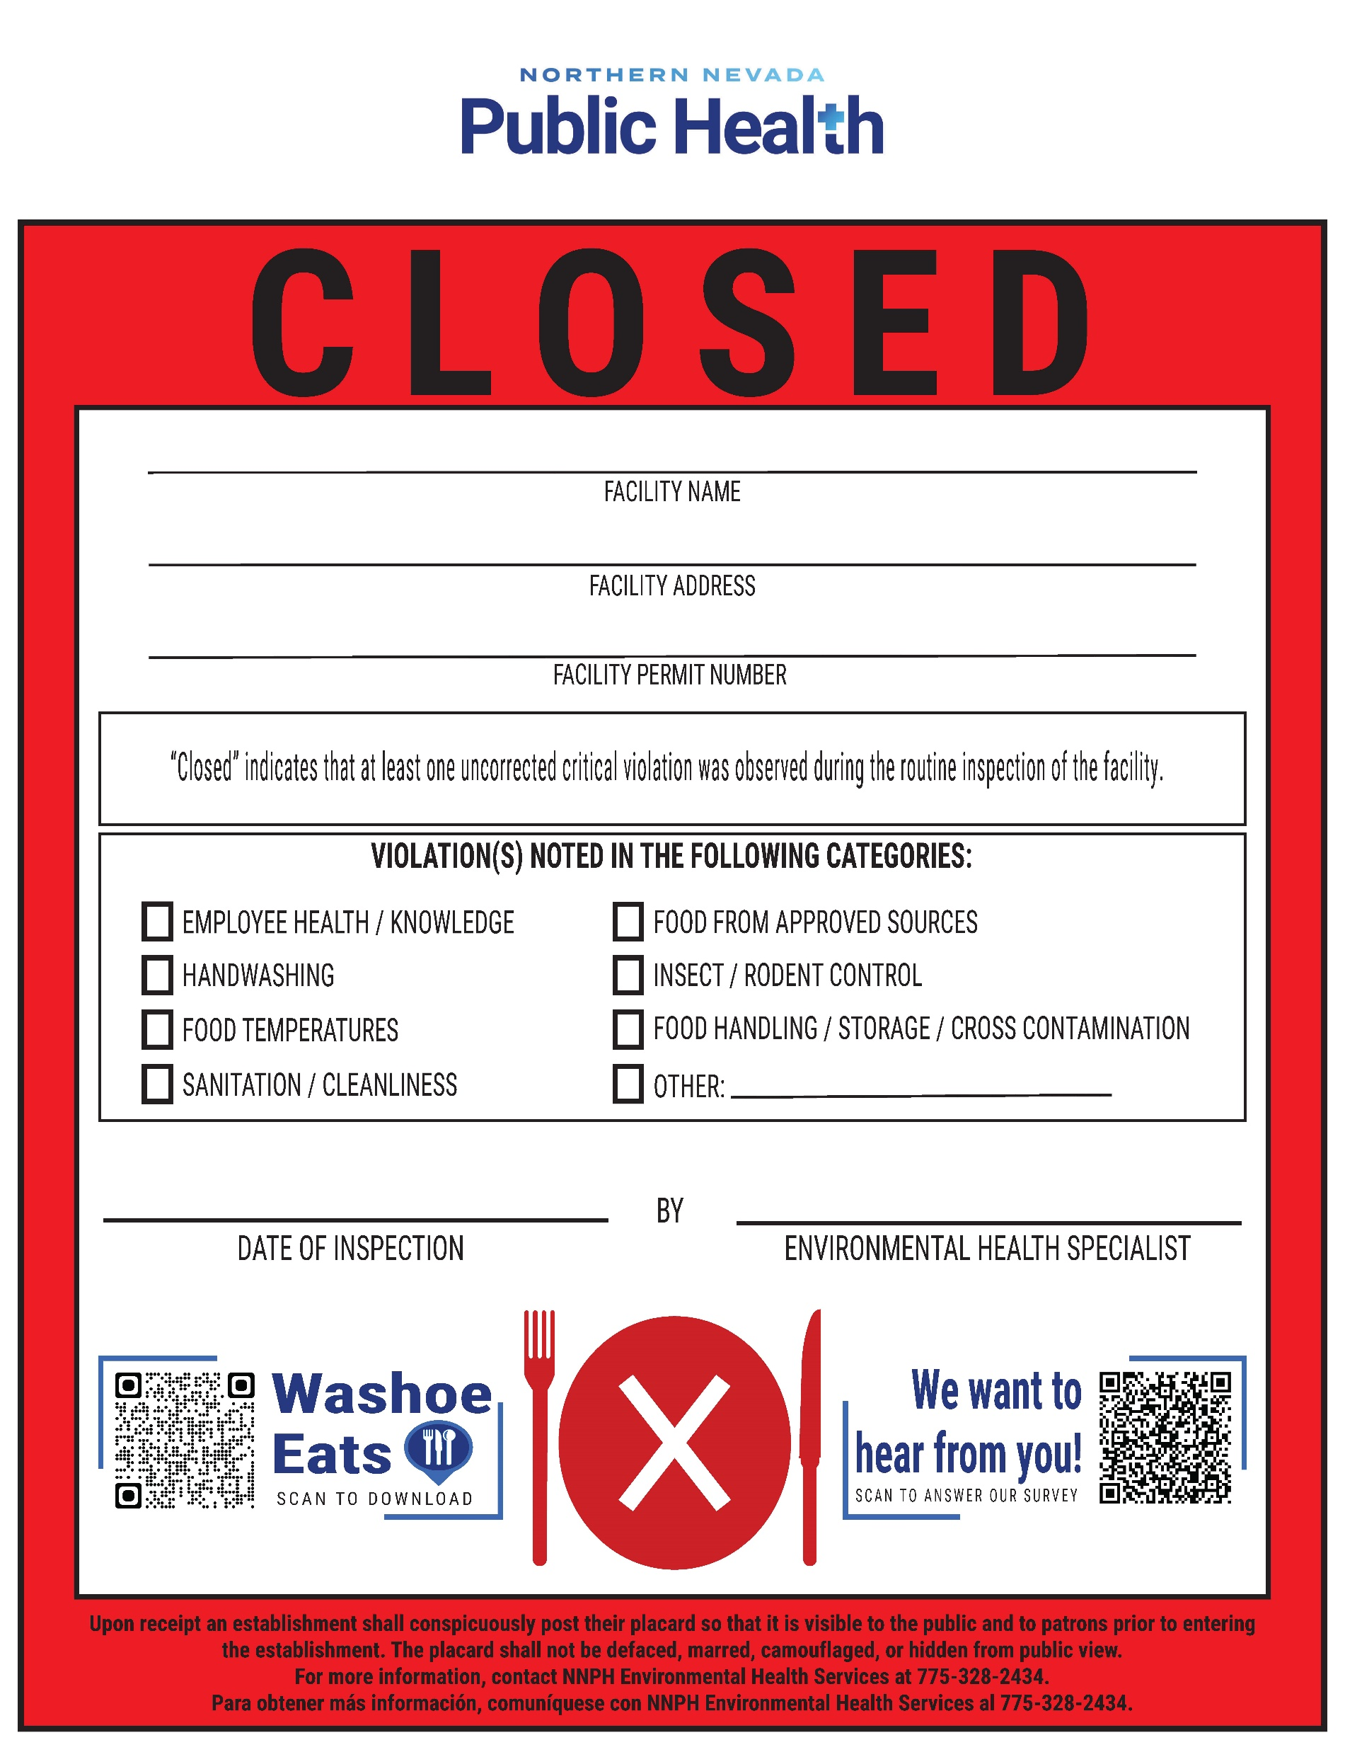
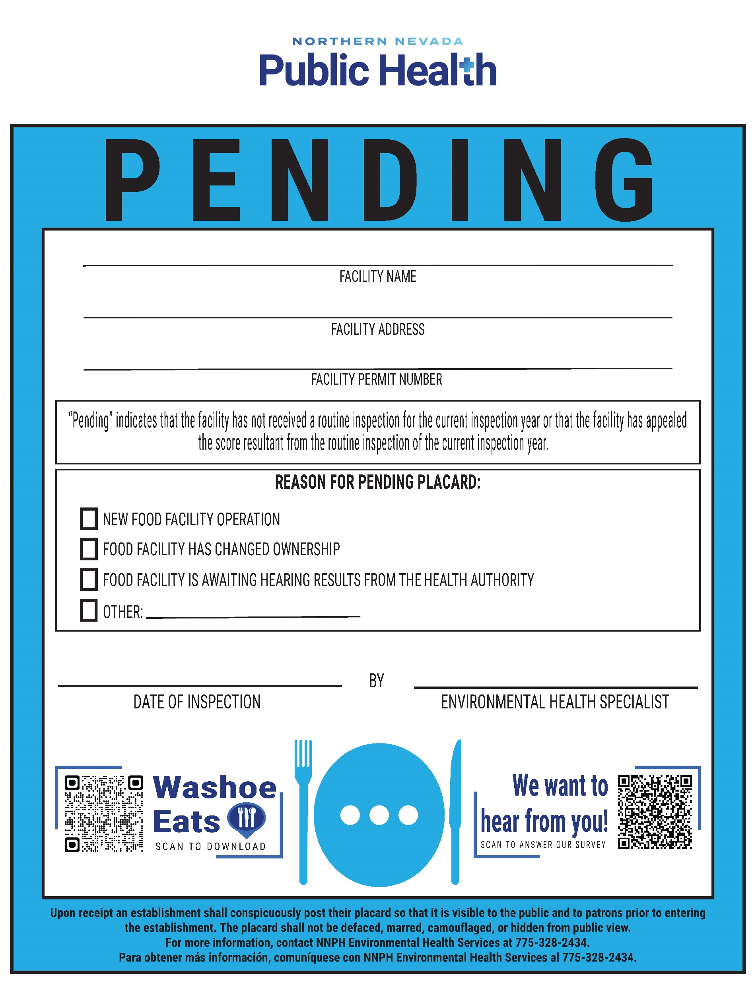
Placarding Inspection Results January 2024
Notes:
Starting in January, we are going to offer and encourage voluntary placarding, so that food establishments post their health inspection scores in an area visible to patrons and customers. Here at NNPH and in partnership with Washoe County’s food establishment operators, we want to make sure that all of our community members are properly informed to make their own health decisions. Placarding is one facet of our effort to inform our community members.

Slide 23
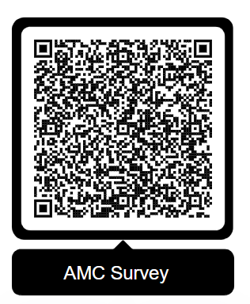
DON’T FORGET!!
Please take this survey by scanning the QR code.
THANK YOU!!

Slide 24
Questions?
Northern Nevada Public Health
Environmental Health Services (775) 328-2434 ext. 8
Email: foodsafety@nnph.org
Notes:
So that’s the end of the AMC class. Does anyone have any final questions?
If you think of any questions later on, you can call the EHS front desk to be connected to an inspector or you can email the food safety email and we will get back to you as soon as possible.
I will be sending out a follow-up email with some helpful links and an AMC Program Certificate. If you have any questions about the course, please reach out.

